Slide 1
Senior Project Integrating Task Management Tools
William Baldwin CIS 598 Spring 2016

Slide 2
What is happening?
I work at GE Aviation here in town
I’ve been tasked with integrating two tools: 1) IBM’s Rational Team Concert (RTC) tool 2) In-house Task Management System

Slide 3
1) Rational Team Concert (RTC)
Subset of IBM’s ALM suite
ALM = Advanced (Software) Lifecycle Management
ALM encompasses entire software development process
Requirements
Source control
Task tracking
Metrics tracking
Testing
RTC deals with the Source Control and Task/Metrics tracking portion of this
Sort of like a mix between Git and JIRA
Agile Development
Source control and keeping track of who’s working on what.

Slide 4
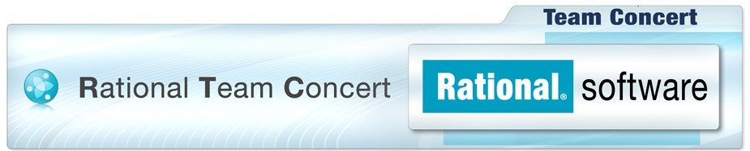
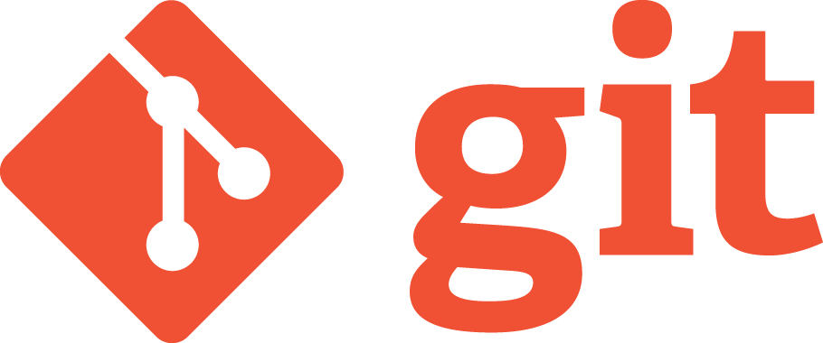
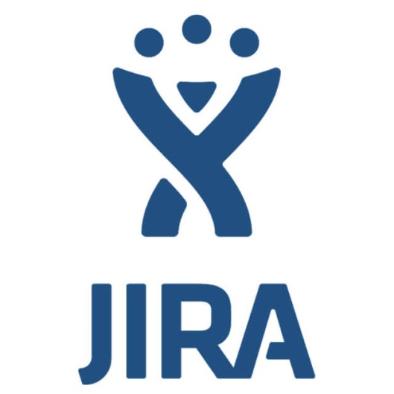
RTC

Slide 5
2) Task Management System
It’s proprietary, so I can’t say that much about it or how it works.
We can think of it as a black box.

Slide 6
Three main features
Pull tasks from RTC into Task Management System
Send results from Task Management System back to RTC.
Give a list of tasks to Task Management system to see what’s changed and run them.

Slide 7
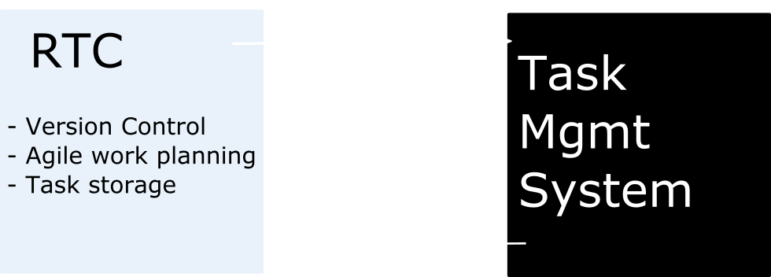
Architecture

Slide 8
Hurdles
Want to integrate seamlessly into existing system.
Task Management System is already a full-fledged standalone tool.
Want to add these features without breaking what’s there already.
For example, I spent 20 hours this week trying to get page navigation to work correctly for both systems.
There are a lot of parts to connect.
The diagram looks super simple, but there are a lot of little details to figure out how to plug RTC in correctly.
They want step 1 functionality by end of week.

Slide 9
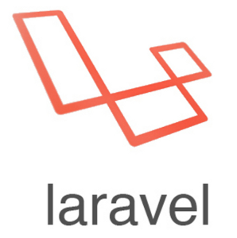

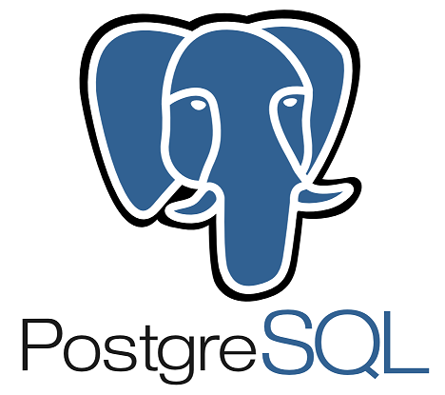

Tools used
Laravel – A PHP framework
Xampp – Website hosting
PostgreSQL – Backing database
GitExtensions – Version Control

Slide 10
Advisor
Dan Andresen is official advisor, but most advising will be by managers in office.

Slide 11
Questions?

